Slide 1
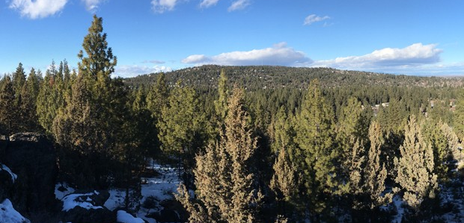
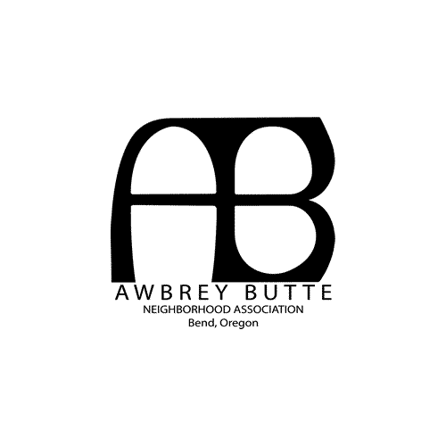
General Members’ Meeting
November 4, 2021

Slide 2
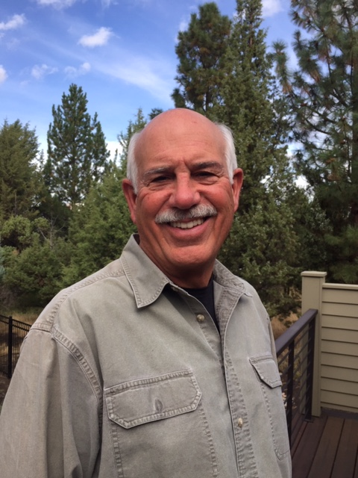
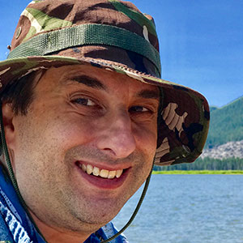
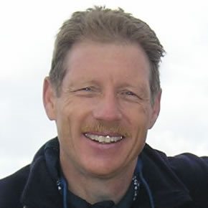
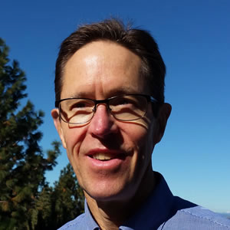
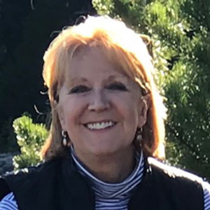
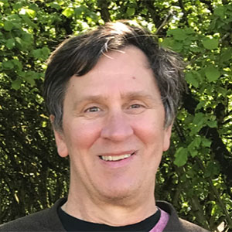
Your ABNA Board Members
Pauline Wilson
Jeff Conrad
Brad Clements
Hans Jorgensen
David Craven
Janelle Sherlock
Chris Pearson
Notes:
Hans will introduce Board members, and mentioning our roles. Will discuss with him. Membership applications are currently handled by Board members Janelle Sherlock and Chris Pearson. I'll mention that we review requests to join ABNA and we send the welcome emails sent to all new members. Chris also is ABNA's representative to the NLA, which is currently addressing NA & NLA membership concerns.

Slide 3
We’ll discuss…
Definitions & Acronyms
ABNA Membership Information
Topics of Concern - Speeding, Street Safety, & Land Use
Light Pollution - Updates for Central Oregon
Member Comments:
Board is listening
Please observe 2-minute time limit
If your topic was previously addressed please acknowledge your support and allow the balance of your time for other speakers
Whether you speak or not, don't hesitate to message the Board at: board@abnabend.com

Slide 4
Homeowners Association (HOA) | Neighborhood Association (NA) | Neighborhood Leadership Alliance (NLA)
Funded by Dues Represents Home Owners Size Subdivision or smaller area of an NA Recognized in City Code No Key Functions CC&R’s ARC Guidelines Design & Aesthetics Neighborhood Amenities | Funded by Tax Dollars Represents Business & Home Owners Renters Size Bend is divided into thirteen NAs Recognized in City Code Yes (Section 1.70) Key Functions Play role in Land Use Represent all residents 18+ Community Building | Funded by Tax Dollars Represents Neighborhood Associations Business & Home Owners Renters Size One representative from each NA Recognized in City Code Yes (Section 1.20) Key Functions Conduit between NAs & City Council Advisory to Council
https://www.bendoregon.gov/community/neighborhood-associations

Slide 5
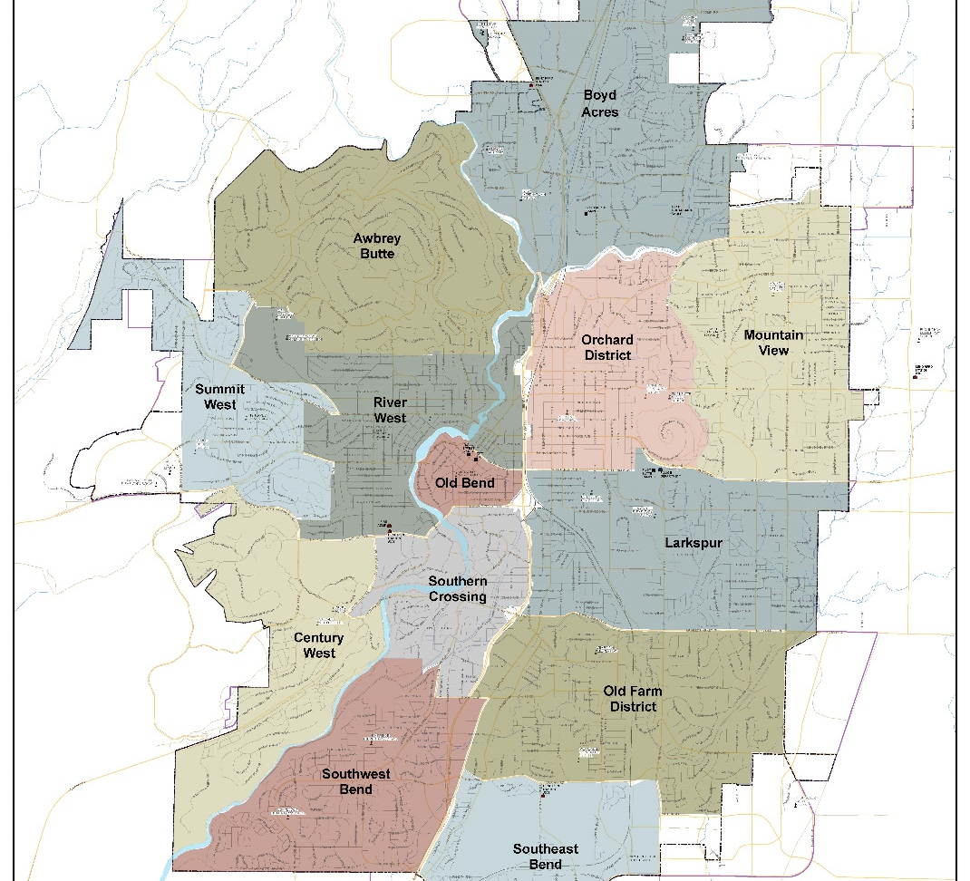
The Bend Neighborhood Associations provide residents the opportunity to help shape the future of their neighborhood and the City.

Slide 6
ABNA Membership Growth 800 members in 580 households in October 2020 to 1300 members in over 900 households in October 2021
Membership drives - mailings from ABNA & City of Bend
Proposed developments on Awbrey Butte
Changes in Development Code resulting from HB 2001, which allows construction of multi-family housing units on almost all lots previously zoned single-family residential
The City's attempts to to address the increasing population of the houseless in Bend
Other issues arising from rapid population growth, including traffic and scarcity of affordable housing

Slide 7
Topics of Concern
Speeding
Street Safety
Land Use
River’s Edge Development
Glassow Drive Development
HB 2001
Compass Corner Development

Slide 8
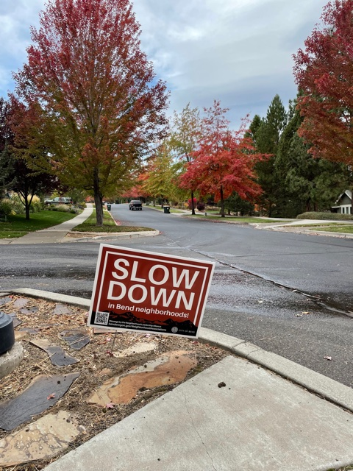
Speeding
Alerting drivers to obey posted posted signs
Purchased Slow Down signs
Deployed Mobile Radar Units
Met with Police Chief Krantz

Slide 9
Street Safety
Leveraged Neighborhood Street Safety Program (NSSP)
Installed permanent speed radar signs
Trimmed vegetation to improve intersection visibility
Signage improvements
New pedestrian crosswalks

Slide 10
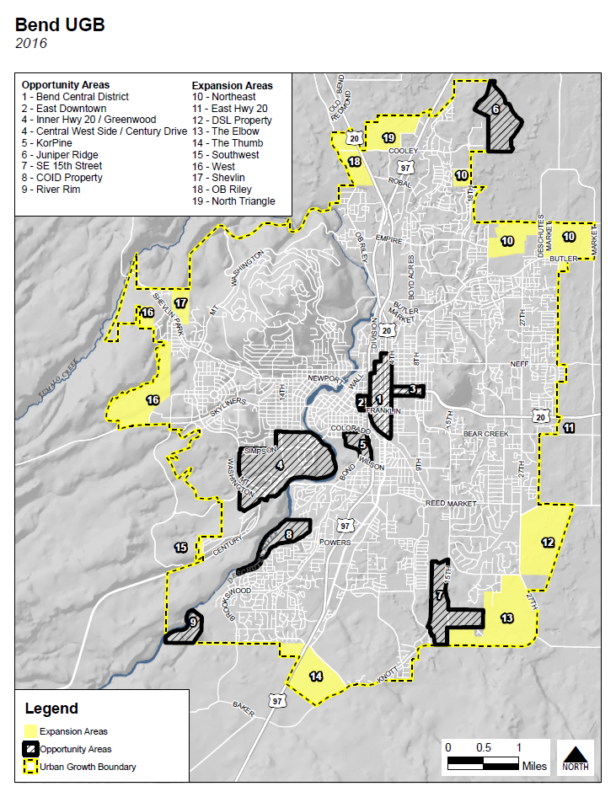
Land Use
Governed by framework of state laws
Development within Urban Growth Boundary
Bend is getting denser
Growth impacting Awbrey Butte

Slide 11
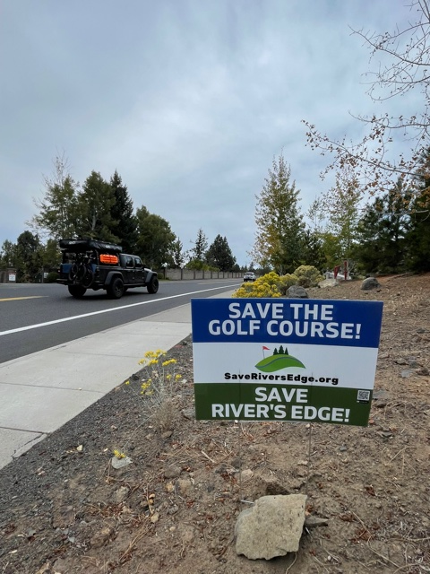
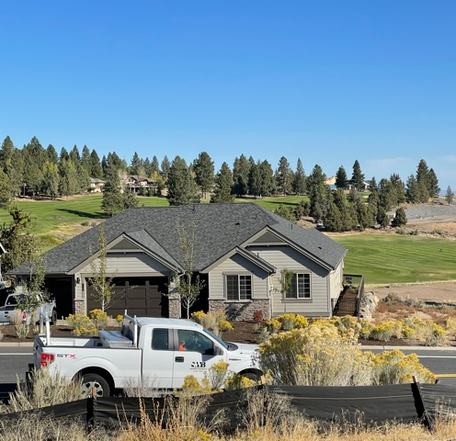
Rivers Edge Developer Proposal … convert golf course into housing
Background:
Proposed sale of golf course
Lawsuits filed by residents
Key Concerns:
Loss of the golf course
372 add’l homes
Traffic impact
Lawsuit Status:
Settlement reached w/ Wayne Purcell
Opportunity to preserve golf course
Notes:
Should we include websites for references? Palisch? Saveriversedge.org?

Slide 12
Compass Corner Development…intersection of Awbrey Road & Mt. Washington
Pre-Application Filing:
2 separate, adjacent buildings, 3/4 floors each
Retail space on ground floor
Upper floors to contain approximately 63 apartments, with 1 level of underground parking
More Information:
Neighborhood meeting November or December, TBD
https://cityview.ci.bend.or.us/Portal/Planning/Status?planningId=322, Project Code # PLPRE20210027

Slide 13
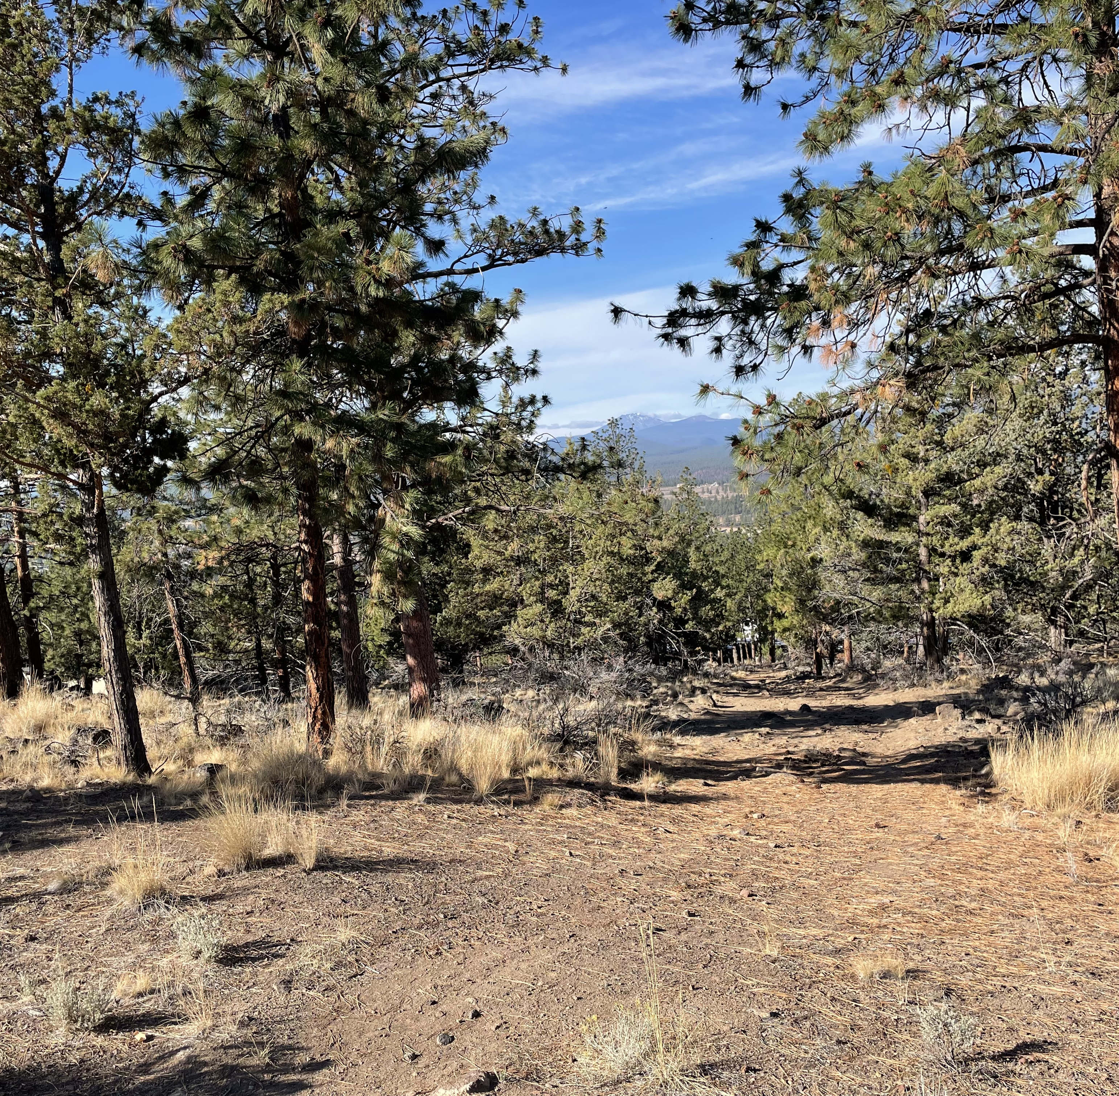
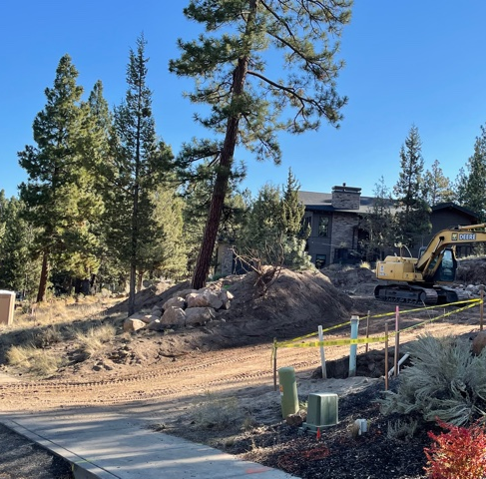
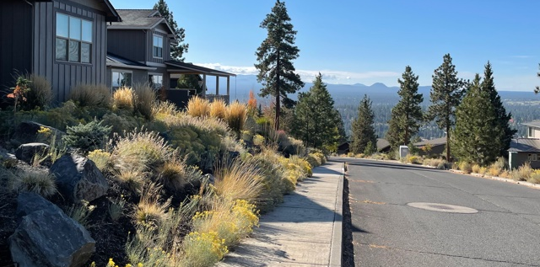
Proposed West View Subdivision off Glassow Road … construct 42 duplexes, triplexes, quads
Background:
Single-family home on large lots
Neighbors accept development, but should be single-family units
Steep road grades
Petition sent to City Council / Planning Commission - - No Response
Key Concerns:
Loss of neighborhood character
Density issues
Traffic impact / safety

Slide 14
HB 2001 …designed to increase Middle Housing, but implementation is problematic
SF Residential must allow duplexes, triplexes, quads, cottage clusters
Education & input limited vs. other cities
NLA requested more public outreach; no response rec’d
Some code changes are problematic e.g., reduction/elimination of off-street parking requirements
City Council passed proposed code changes.
Changes to Bend Development Plan & Comprehensive Plan effective Nov 5

Slide 15
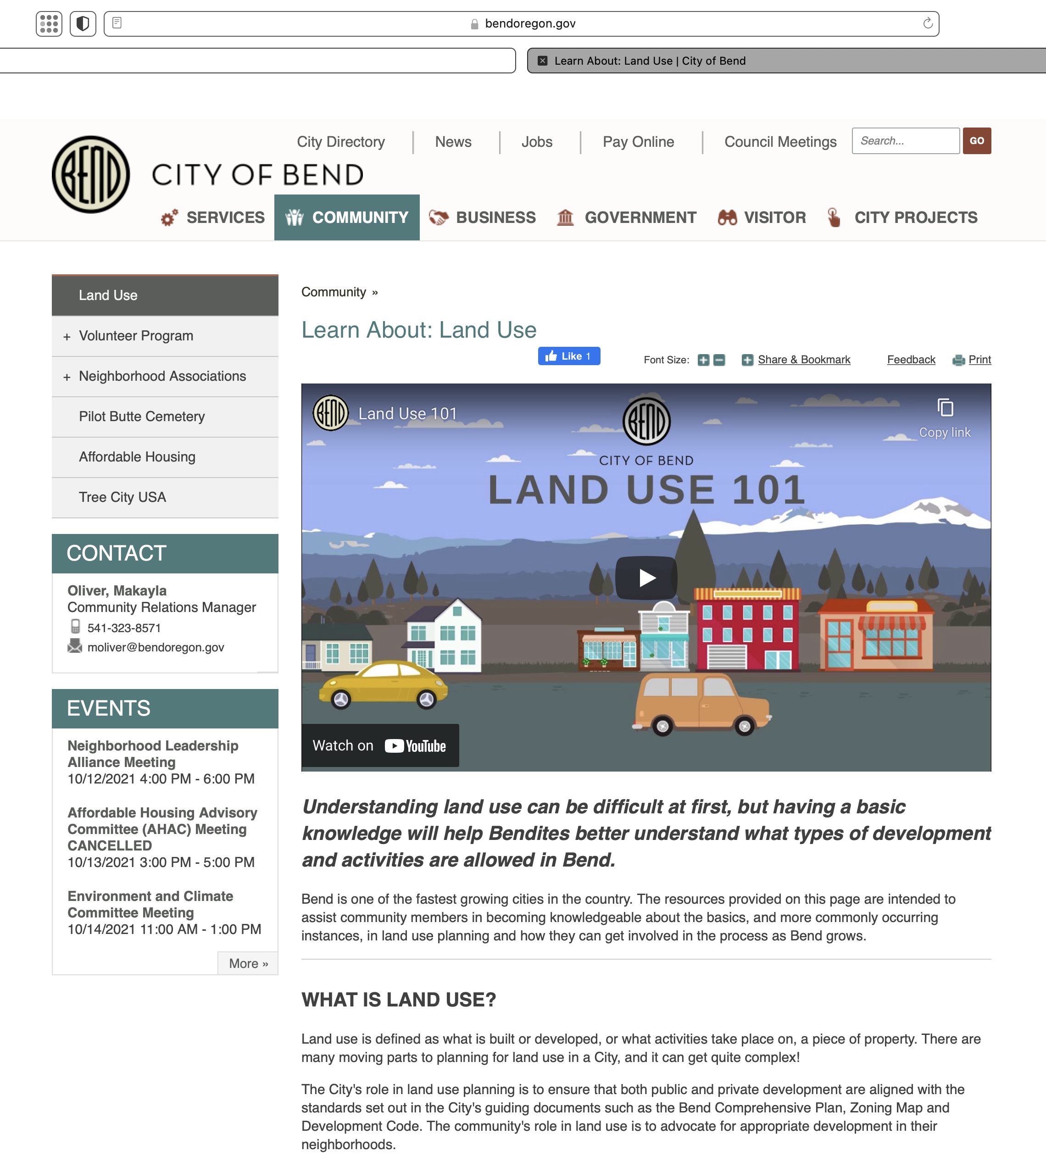
Land Use Resource Guide
Development & activities allowed in Bend
Helps navigate processes & procedures
Guide is housed on City Website: https://www.bendoregon.gov/community/land-use
Take A Minute To Check It Out

Slide 16
Cathie Flanigan, MBA Treasurer, Oregon Chapter of International Dark-Sky Association cathie.flanigan@darksky.org www.darkskyoregon.org
Light Pollution?
Updates for Central Oregon

Slide 17
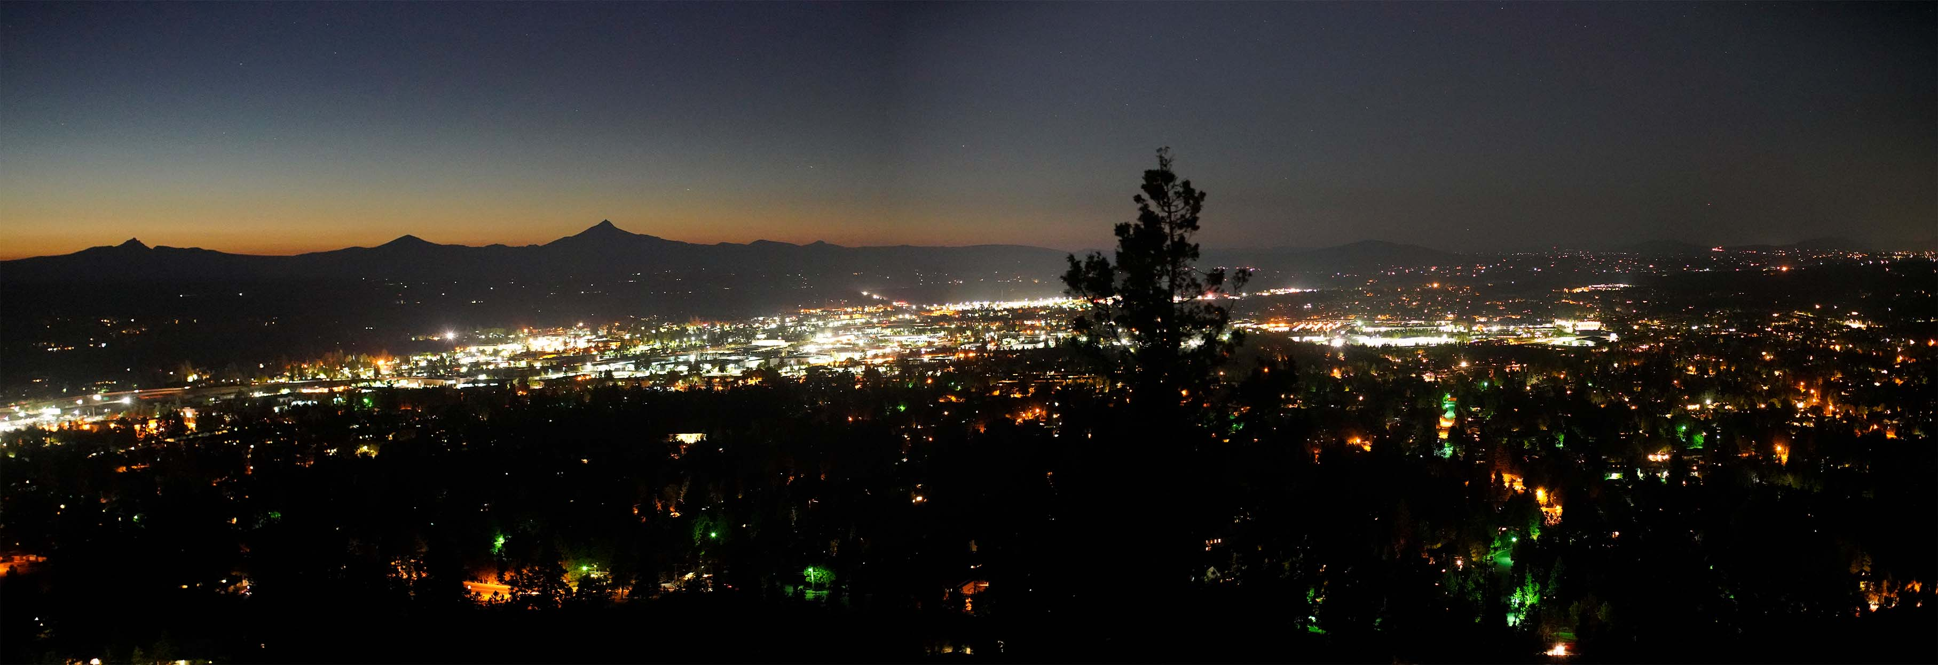
Light pollution is the inappropriate or excessive use of artificial light at night.
City of Bend, viewed northwest from Pilot Butte
About 35% of light is wasted – unshielded and/or poorly aimed amounting to $3 Billion/year of energy lost in the USA.
There are 15 Million tons/year of CO2 emissions from residential outdoor lighting,
of which 5 Million tons/year of CO2 emissions are wasted.
*US DOE 2011 Data
August 18, 2019 8:17 PM

Slide 18
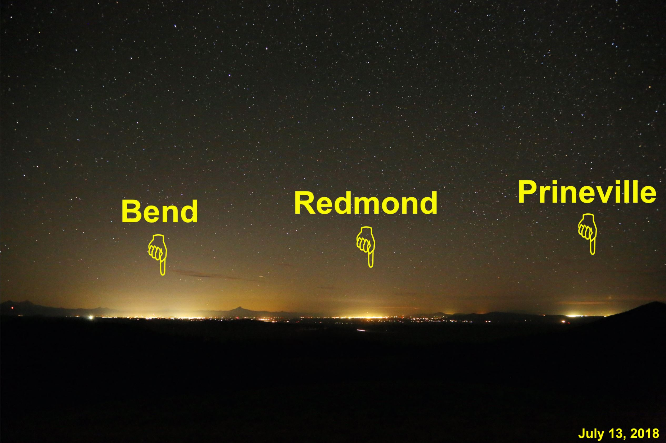
Skyglow – Light Pollution – is a problem in Central Oregon
View northwestward from
Pine Mountain Observatory
July 13, 2018 11:34 PM

Slide 19
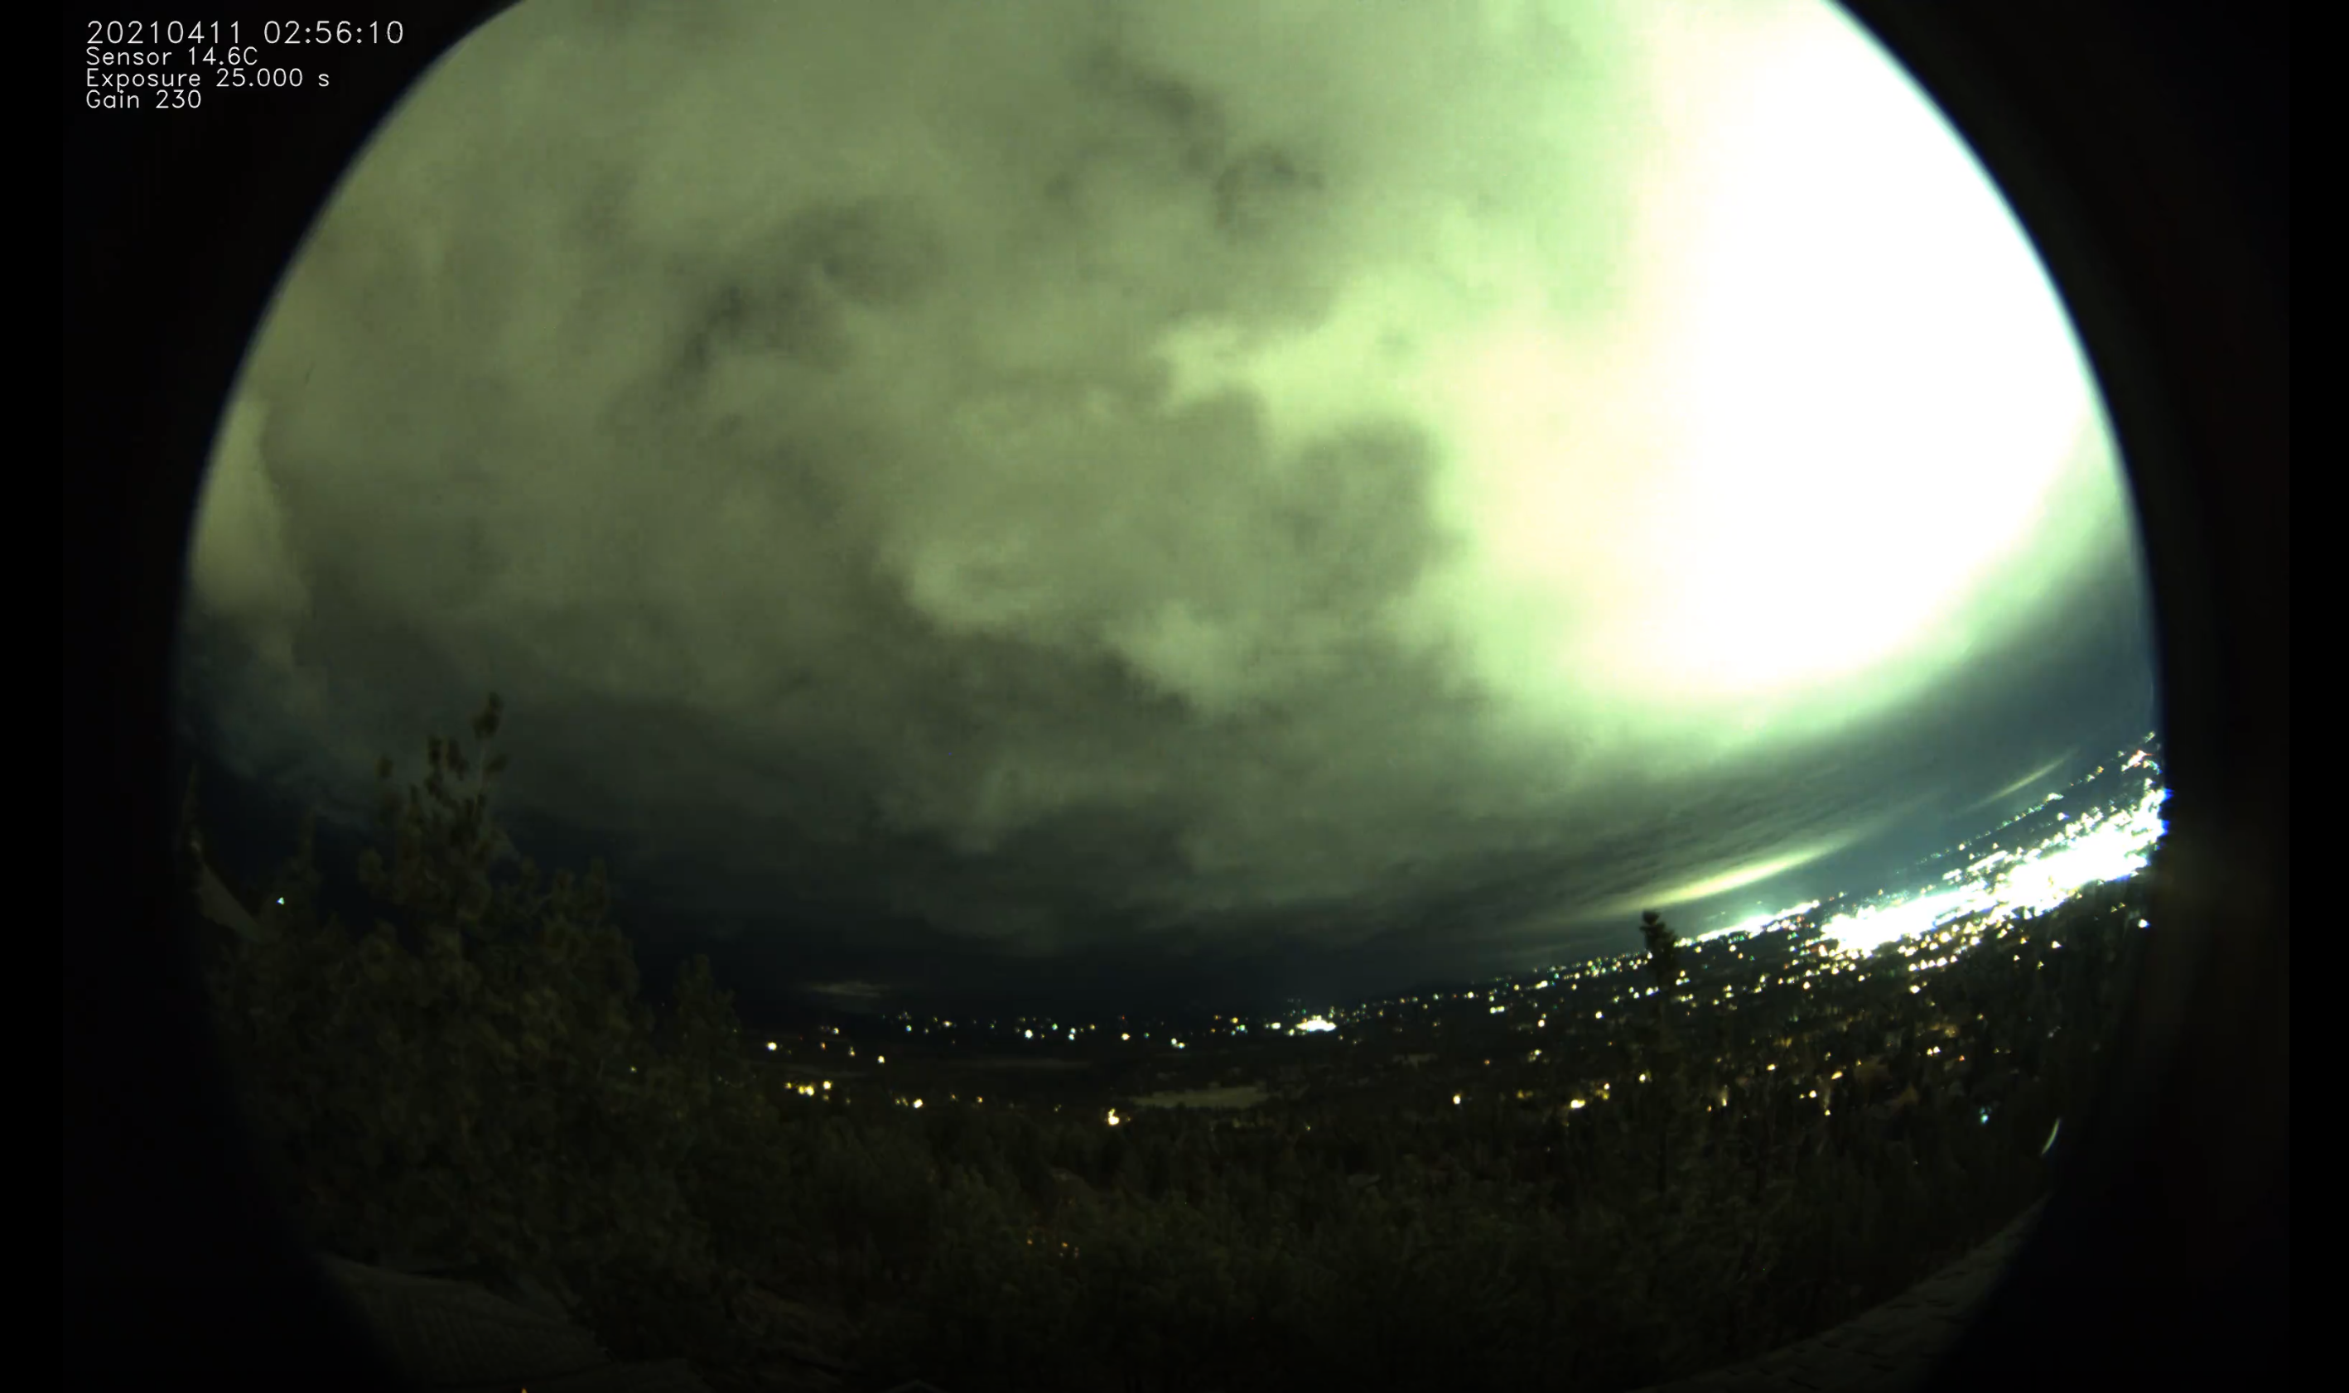
Skyglow – Light Pollution – is a problem in Central Oregon
US-97 Lights reflecting
down from clouds
US-97 North
Lights on all night
Wastes energy,
Carbon footprint,
Light pollution
View north from Awbrey Butte, All-sky camera
April 11, 2021 2:56 AM

Slide 20
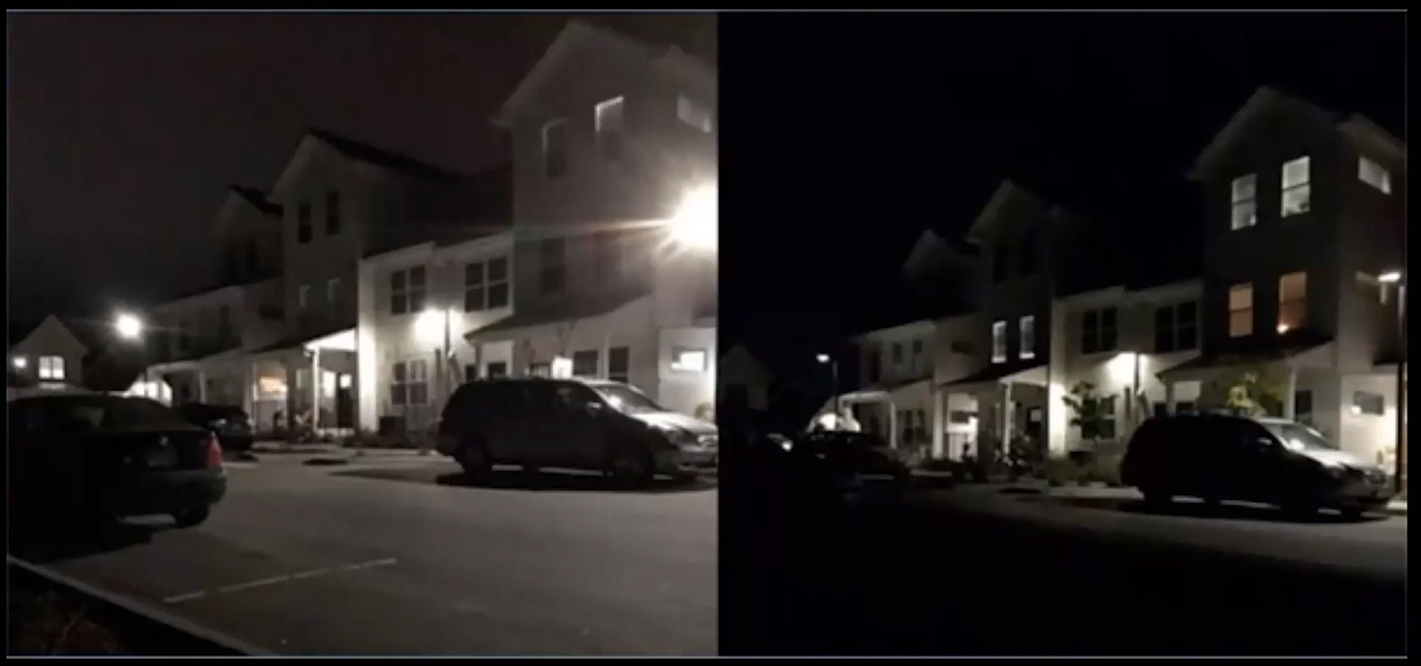
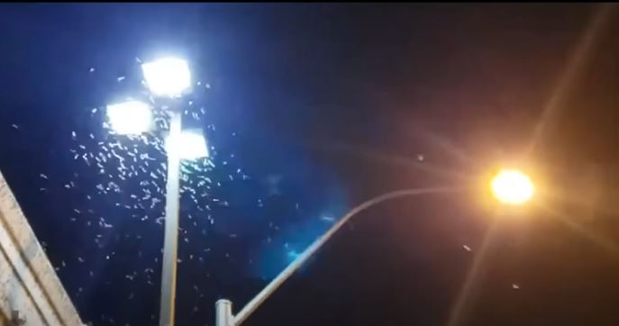
Why does it matter?
It can have serious environmental consequences for humans, wildlife, and our climate,
and it hinders astronomy. It disrupts the circadian rhythm of all life forms.
Moths at blue-white light
Amber light
Moths trapped by blue-white light.
Insects don’t see the amber and warm-white light.
Unshielded lights trespass into bedrooms
After lights were shielded

Slide 21
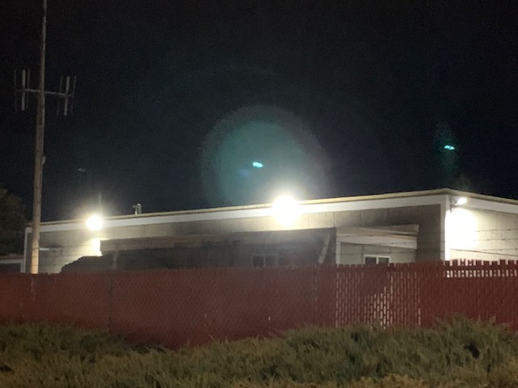
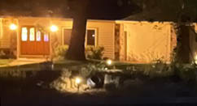
Good and Bad Lighting - Examples from Bend
Bad Lighting
Not shielded
Glare in drivers face
Very Bright
Light Trespass off the property
March 18, 2021 9:26 PM
Good Lighting
Shielded by roof overhang
Adequately bright for safety
Light stays on the walkway – no light trespassing
March 18, 2021 9:28 PM

Slide 22
Safety & Security
www.darkskyoregon.org

Slide 23
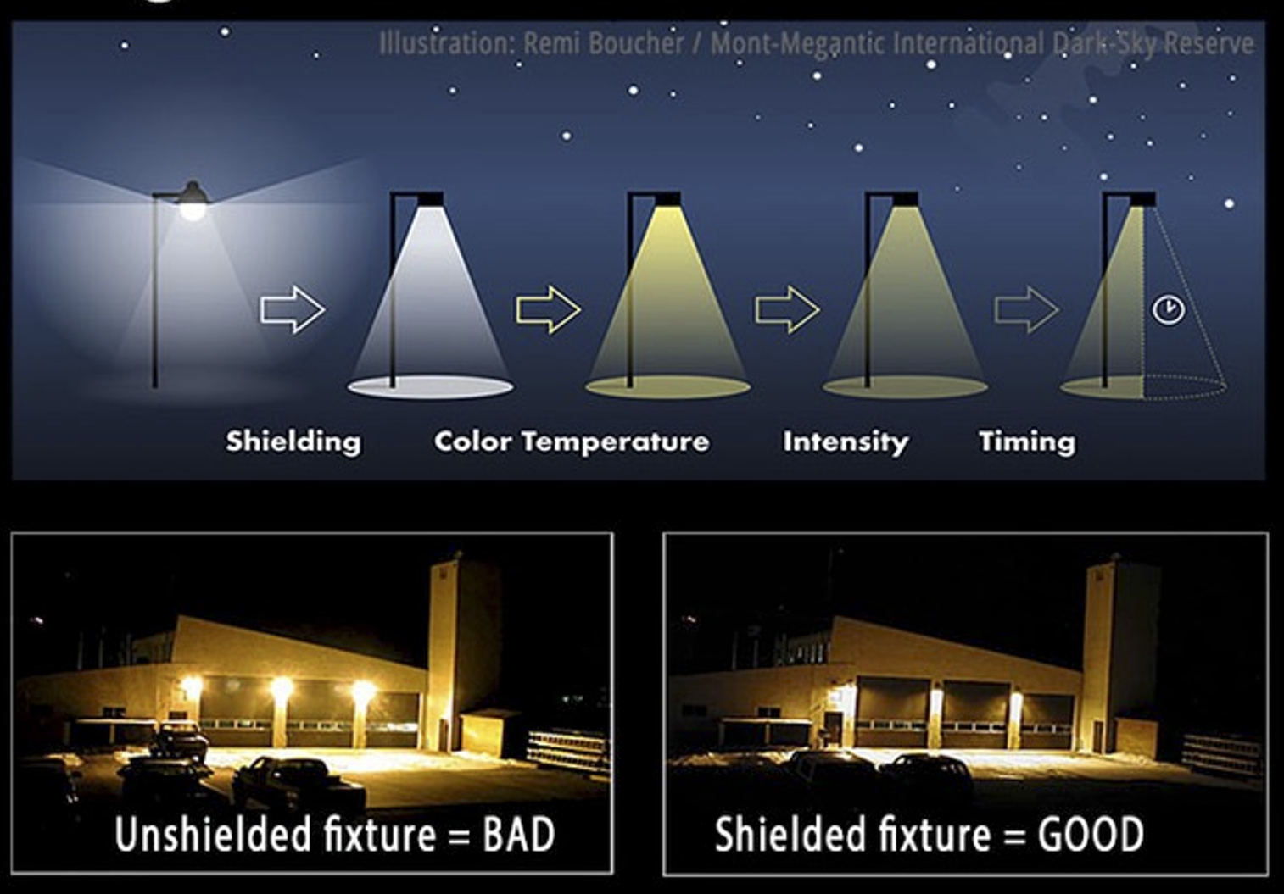
What you can do to Minimize Light Pollution
www.darkskyoregon.org

Slide 24
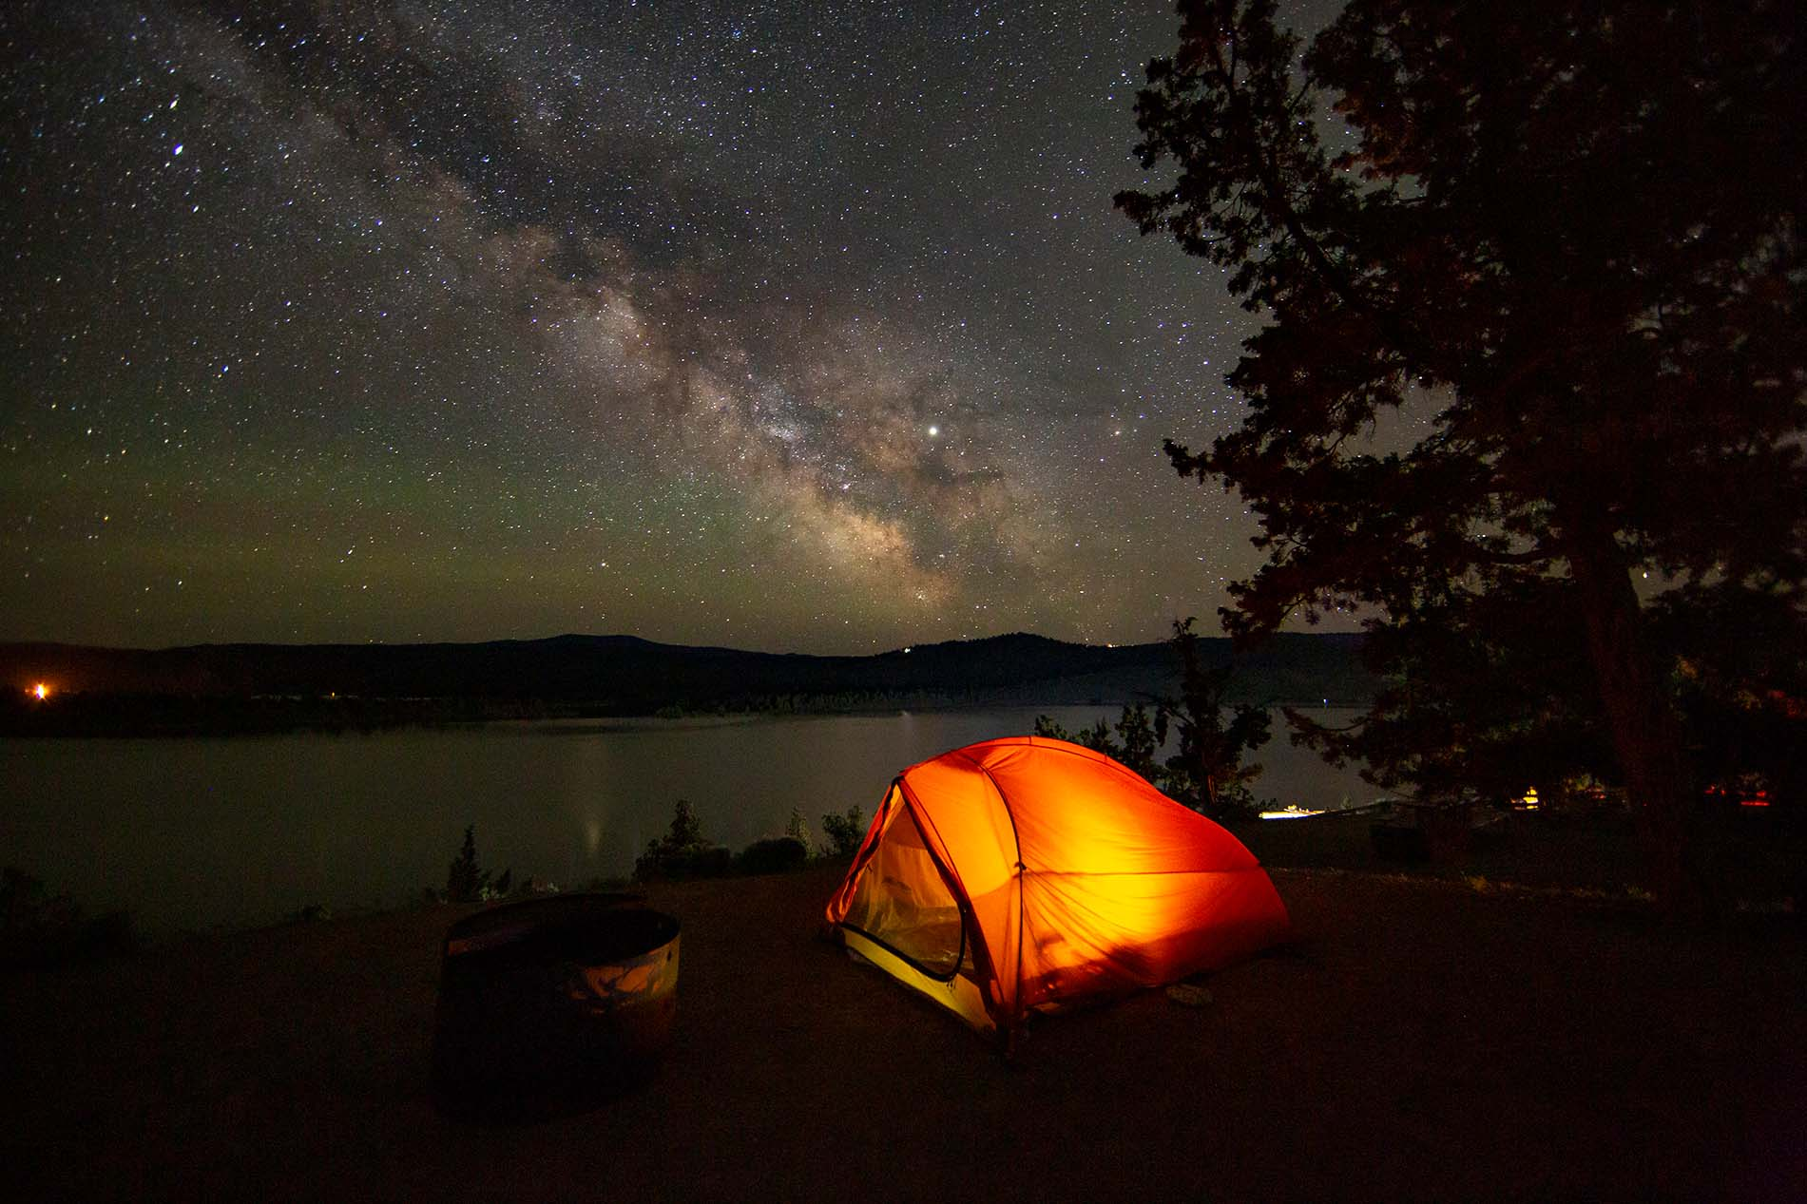
Oregon’s First International Dark-Sky Park
www.darkskyoregon.org
cathie.flanigan@darksky.org
Prineville Reservoir State Park
Photo by Dawn Davis

Slide 25
Links & Resources
Awbrey Butte Neighborhood Association: www.abnabend.com
Awbrey Butte NA Board: board@abnabend.com
Awbrey Butte NA Council liaison: bcampbell@bendoregon.gov
City Council, all: council@bendoregon.gov
Bend Community Relations Manager: moliver@bendoregon.gov
Planning Commission (land use): cityplanningcommissionall@bendoregon.gov

Slide 26
Links & Resources, cont’d
Report Graffiti: https://sheriff.deschutes.org/community/crime-prevention/reporting-graffiti/
Request Pothole Repair: https://www.bendoregon.gov/government/departments/streets/street-operations/pothole-repair or call 541-317-3000
International Dark Skies Association: cathieflan@gmail.com
City Senior Planner: phardie@bendoregon.gov

Slide 27
Welcome! Take your seat at the table!
The Board is your voice to Council and Staff, don’t hesitate to contact us
Share your views with other AB Members on the Member’s only Forum on the ABNA website
Land Use is often a hot topic and can be complex, rely on your Land Use Chair and take advantage of the comprehensive land use education tools on the City’s website
Membership matters, please encourage your Awbrey Butte friends and neighbors to register with ABNA and join our Awbrey Butte Facebook Group
Please consider attending an ABNA Board meeting, also consider supporting the Awbrey Butte community by working with the Board

